Slide 1

Robot Serving in Hospital (Nurse)

Slide 2
Presented By:
 | Name | ID
1 | Shams Yusef Ibrahim Muhammed | 19-01104
2 | Nourhan Ahmed Mohamed Mohamed Ali | 20-01654
3 | Amal Mahdy Ahmed | 20-01968
4 | Mahmoud Zaker Ahmed Zaker | 20-01891
5 | Khaled Mahmoud Muhammed El-Taher | 20-01818
6 | Mahmoud Abdelaziim Morsy | 20-00509
7 | Domadios Hany Samir | 20-00724
Supervised By:
Asst. Prof. Dr. Mahmoud Muhammed Hussein
TA. Muhammed Fikry

Slide 3
Table Of Content :
 | Page | Content
1 |  | Introduction
2 |  | Motivation
3 |  | Analysis
4 |  | Methodology
5 |  | Implementation
6 |  | Conclusion & Future Work

Slide 4
Introduction
Robot service in hospital refers to the use of robots to provide various services in a hospital. These robots are designed to perform tasks such as Medication Delivery, Vital Sign Measurement, Patient monitoring and Physical assistance.
Typically, robots perform tasks that are either highly repetitive or too dangerous for humans to conduct safely.
The use of robots in hospitals is becoming increasingly popular due to their efficiency, accuracy, and ability to work around the clock without getting tired or making mistakes.

Slide 5
Benefits of the proposed model:
1. Reduces labor requirements.
2. Reduces wait time for patients.
3. Longer working hours than humans.
4. Saves money and human resources.
5. Reduces operating costs.

Slide 6
Motivation
Problem Definition:
The healthcare industry, particularly in the context of nursing, faces numerous challenges such as staffing shortages, increasing patient demands, and limited resources. These challenges often result in overworked nurses, higher rates of burnout, and compromised patient care quality.
And in the context of the COVID-19 pandemic, the healthcare industry faced unprecedented challenges, including overwhelmed hospitals, strained healthcare resources, and heightened risks for healthcare workers. Nurse robots emerged as a potential solution to alleviate some of these challenges and enhance the capacity and efficiency of healthcare delivery during the crisis.

Slide 7
Issues:
Technical Difficulties: Nursing robots can malfunction or break down, causing delays in patient care and potentially compromising patient safety and well-being.
Limited Capabilities: Robots may not be able to perform all tasks required in a healthcare setting, such as responding to complex patient needs, or handling emergencies.
Lack of Personal Touch: Some patients may prefer human interaction.
Cost: Implementing robotic systems in healthcare can be expensive, and the cost may not be feasible for smaller facilities.
Job Displacement: The use of robots in healthcare could lead to job loss for human workers, which could have negative social and economic impacts.

Slide 8
Objectives:
Increase efficiency: Nurse robots can perform repetitive tasks such as monitoring vital signs, delivering medication, and transporting supplies, freeing up human nurses to focus on more complex tasks.
Reduce labor costs: By using robots for certain tasks, healthcare facilities can reduce their labor costs and allocate resources more effectively.
Improve accuracy: Nurse robots are programmed to perform tasks with a high degree of accuracy, reducing errors in any routine procedures.
Increase safety: In the context of infectious diseases, such as during the COVID-19 pandemic, nurse robots can help reduce contact between patients and healthcare staff, increasing safety for both patients and caregivers.

Slide 9
Analysis
In our quest to unlock new horizons in patient care, we embarked on a journey of discovery, engaging with hospitals and healthcare professionals to explore the feasibility and potential of integrating nurse robots into their clinical environments. Through insightful discussions and firsthand observations, we uncovered a wealth of perspectives and insights that underscored the transformative role nurse robots can play in modern healthcare settings.
We used (Use Case) methodology in our system analysis to identify, clarify, and organize our system requirements. And to specify the roles played by the actors within the system and the relationships between and among them.

Slide 10
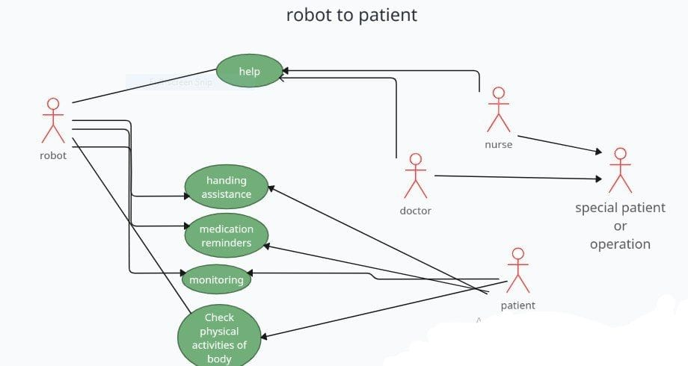

Slide 11
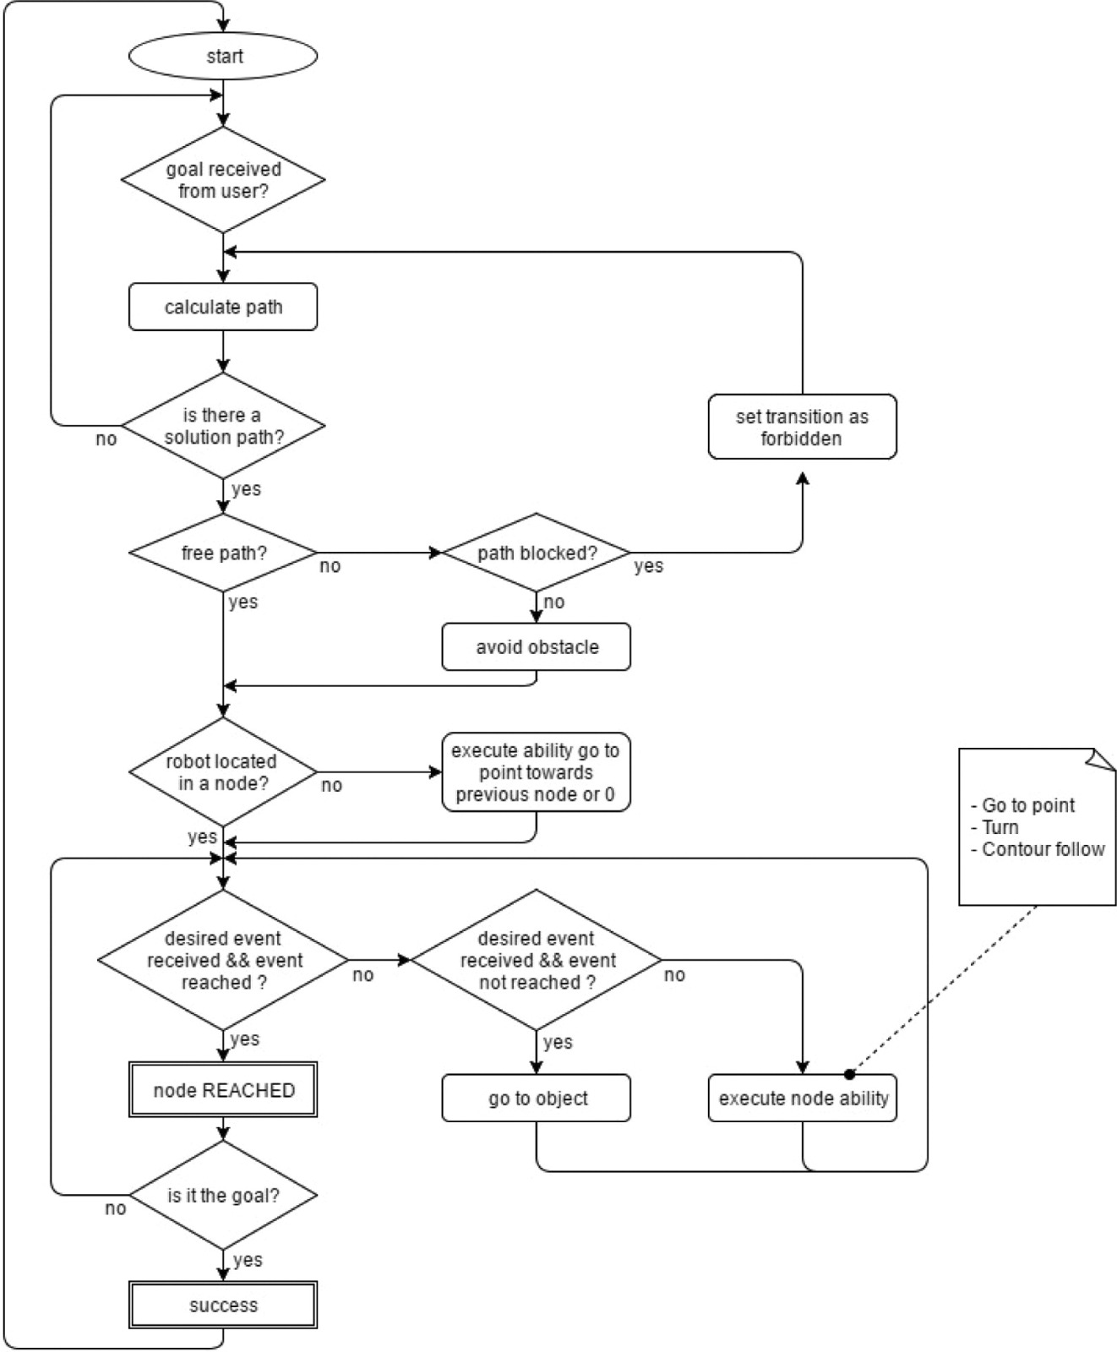

Slide 12
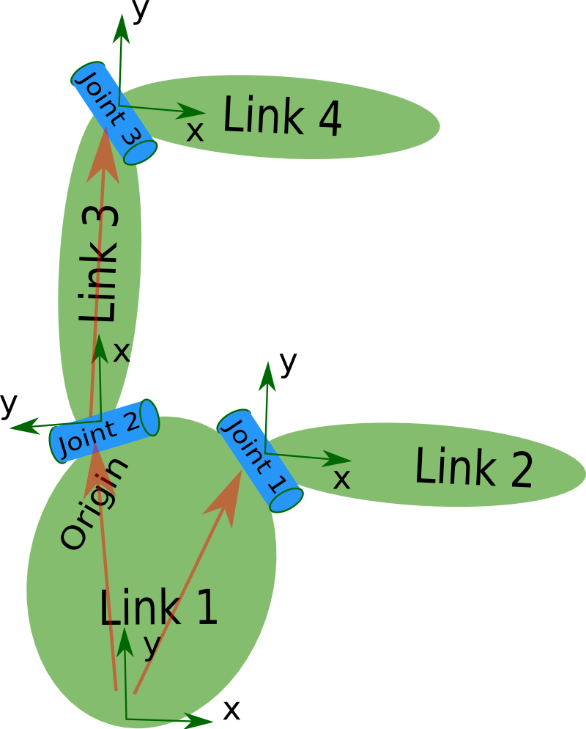
Methodology
URDF
The Specification Covers URDF:
Kinematic and dynamic description of the robot.
Visual representation of the robot.
Collision model of the robot.
The Description Of a Robot Consists Of:
A set of link elements. <link> …. </link>
A set of joint elements connecting the links together. <joint> …… </joint>
<robot name="pr2">
<link> ... </link>
<link> ... </link>
<link> ... </link>
<link> ... </link>
<joint> .... </joint>
<joint> .... </joint>
<joint> .... </joint>
</robot>

Slide 13
Control Scheme Of Modern Mobile Robot:
Sensors
Localization
Path Planning
Control
Actuators
Map
Map
Information about
the environment
Ego-pose determination

Slide 14
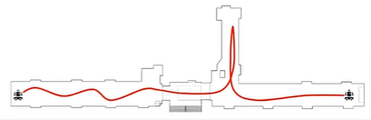
Localization :
In robotics stands for the process of tracking robot pose (Determines its position and Orientation) within a given environment (some fixed reference frame).
2D: (x, y, ө)
State space
3D: (x, y, Z, φ ,ψ,ө )
Localization
Inside buildings
(Indoor)
Environment
On open space
(Outdoor)

Slide 15
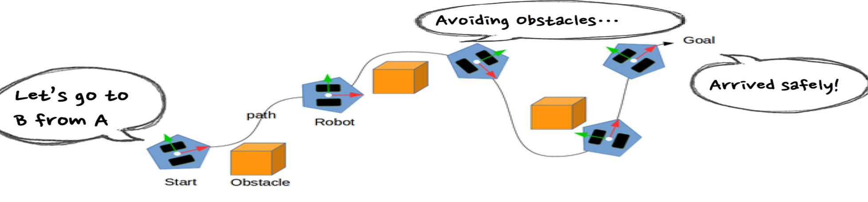
Why Localization Matter ?
Knowing precise pose is a prerequisite for accurate motion planning and execution.

Slide 16
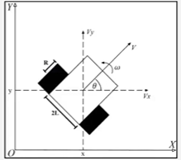
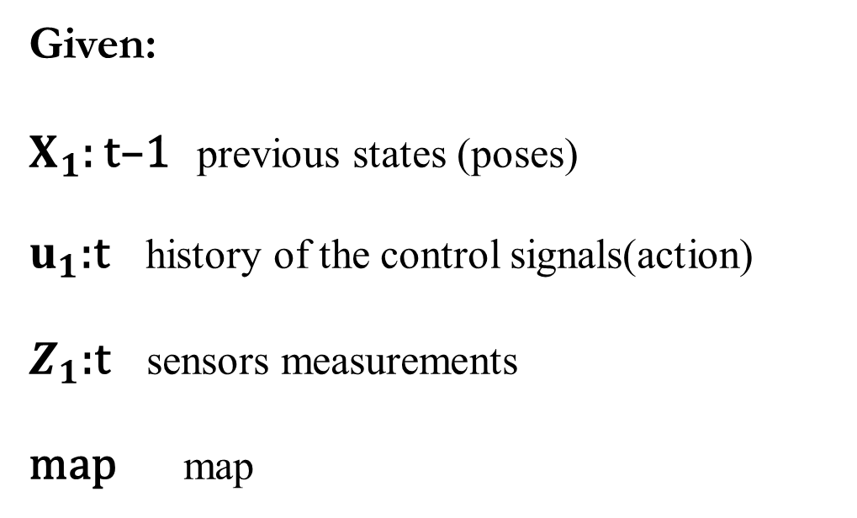
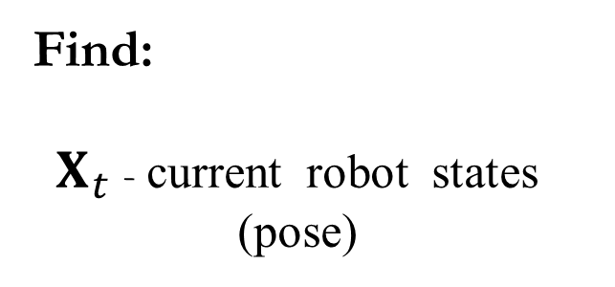
Formal Localization Problem Definition:
Given:
$X_{1}$: t–1 previous states (poses)
$u_{1}$:t history of the control signals(action)
$Z_{1}$:t sensors measurements
map map
Find:
$X_{t}$ - current robot states (pose)

Slide 17
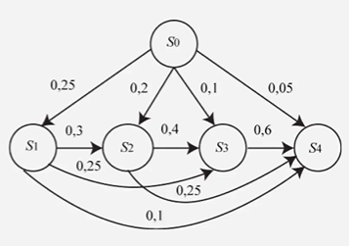
MarkoV Process:
MarkoV process: is a probabilistic approach where the robot maintains a probability distribution over its possible locations.
How it works? The robot updates its belief about its location based on sensor measurements and movement commands. It uses the Markov property to update its belief state: the current belief state is updated based on the previous state and the current sensor readings without needing to account for the entire history.
Markov property:

Slide 18

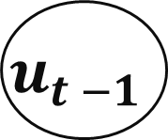
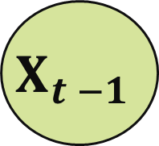

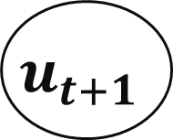
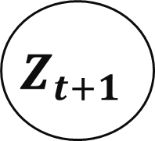
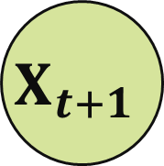
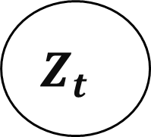
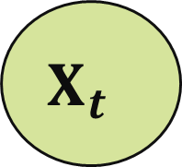
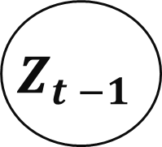
Localization as Hidden MarkoV Process:
map
$$Z_{t −1}$$
$$Z_{t }$$
$$Z_{t+1}$$
$$X_{t −1}$$
$$X_{t }$$
$$X_{t+1}$$
$$u_{t −1}$$
$$u_{t }$$
$$u_{t+1}$$

Slide 19
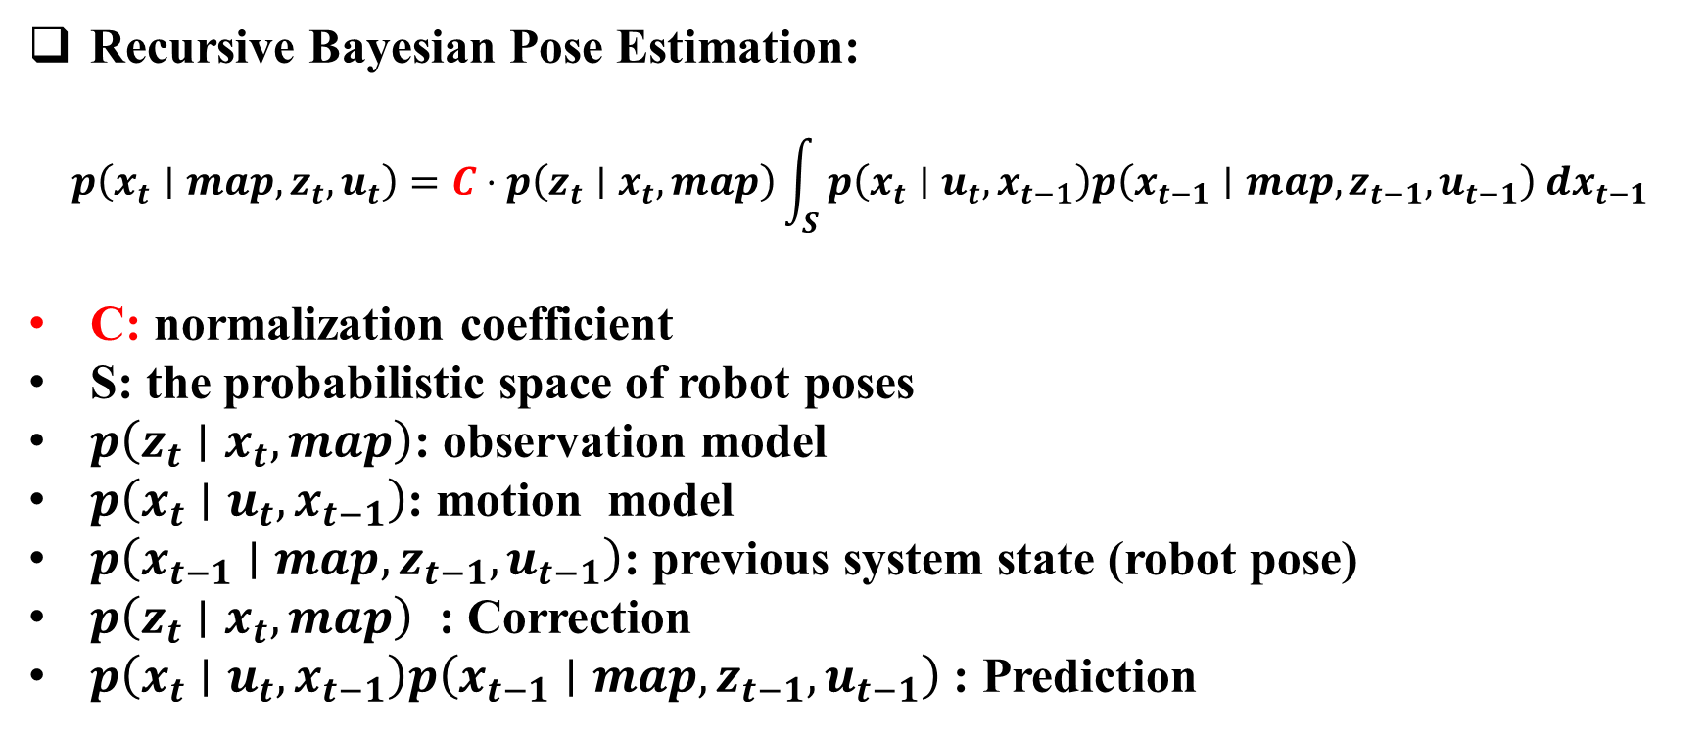
Recursive Bayesian Pose Estimation:
$$p\left(x_{t}∣map,z_{t},u_{t}\right)=C⋅p\left(z_{t}∣x_{t},map\right)\int_{S}{ }p\left(x_{t}∣u_{t},x_{t−1}\right)p\left(x_{t−1}∣map,z_{t−1},u_{t−1}\right) dx_{t−1}$$
C: normalization coefficient
S: the probabilistic space of robot poses
$p\left(z_{t}∣x_{t},map\right)$: observation model
$p\left(x_{t}∣u_{t},x_{t−1}\right)$: motion model
$p\left(x_{t−1}∣map,z_{t−1},u_{t−1}\right)$: previous system state (robot pose)
$p\left(z_{t}∣x_{t},map\right)$ : Correction
$p\left(x_{t}∣u_{t},x_{t−1}\right)p\left(x_{t−1}∣map,z_{t−1},u_{t−1}\right)$ : Prediction

Slide 20
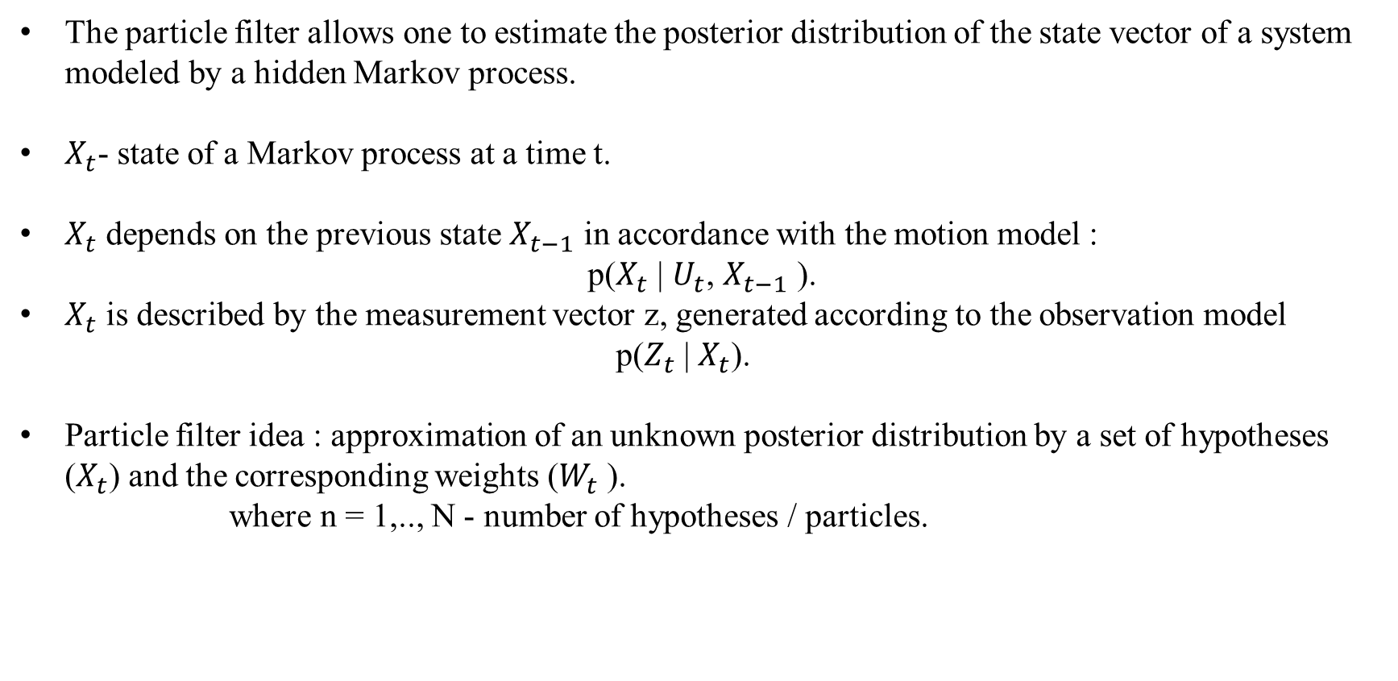
Particle Filter:
The particle filter allows one to estimate the posterior distribution of the state vector of a system modeled by a hidden Markov process.
$X_{t}$- state of a Markov process at a time t.
$X_{t}$ depends on the previous state $X_{t−1}$ in accordance with the motion model :
p($X_{t}$ | $U_{t}$, $X_{t−1}$ ).
$X_{t}$ is described by the measurement vector z, generated according to the observation model
p($Z_{t}$ | $X_{t}$).
Particle filter idea : approximation of an unknown posterior distribution by a set of hypotheses ($X_{t}$) and the corresponding weights ($W_{t}$ ).
where n = 1,.., N - number of hypotheses / particles.

Slide 21
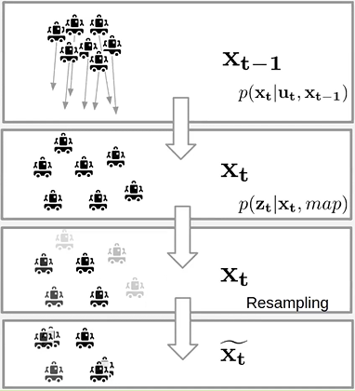
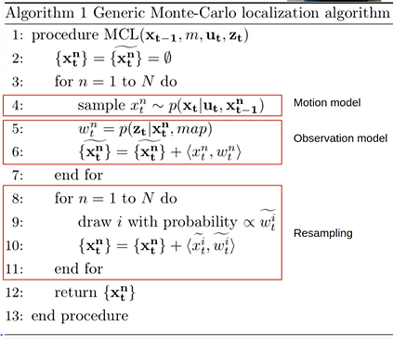

Slide 22
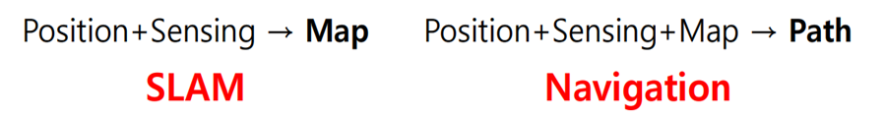
What you need for path finding!
① Position: Measuring/estimating the robot’s position.
② Sensing: Measuring obstacles such as walls and objects .
③ Map: Maps with road and obstacle information.
④ Path: Calculate optimal path to the destination and follow the path.
Localization: is about knowing "Where am I ?".
Navigation: is about determining "How do I get to my goal from here?" and then executing the plan to get there

Slide 23
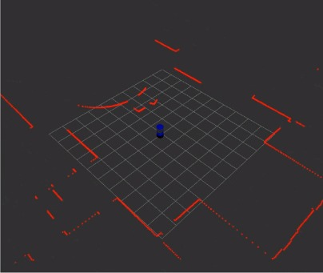
Implementation
Design Robot:
Building Our Robot Using URDF (Xacro)
Launching Our Robot Model In Gazebo:
Run Launch File:
1) Go to workspace:
$ cd catkin_ws/
2) Launch File world.launch:
$ roslaunch rsrobot_gazebo world.launch

Slide 24
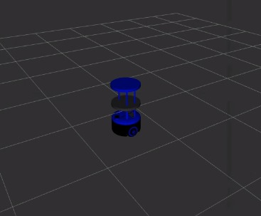
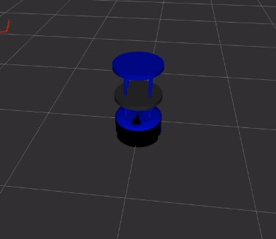

Slide 25
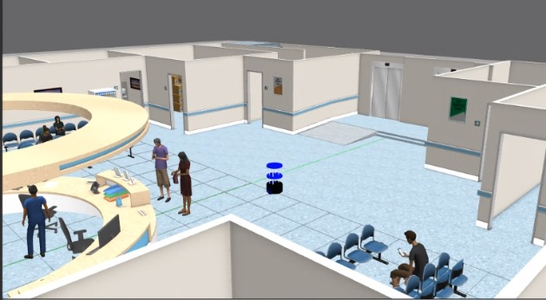
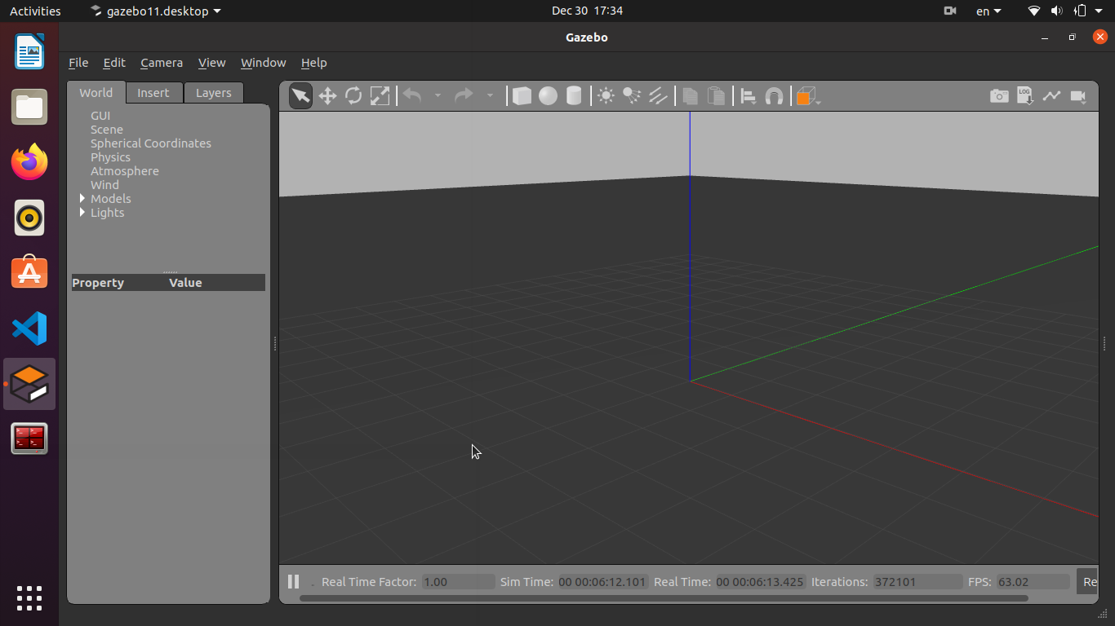
Design Environment:
Building Custom (Model) In Gazebo:
The model is chosen, whether it is a chair and a table or other different models provided by Ros, then it is pulled from the left side of Gazebo and downloaded into the Gazebo environment and building the hospital.

Slide 26
A link explaining the process of building the environment (Hospital):
https://drive.google.com/file/d/1lo21SNywQ7jwrXzfrsAqKf7vhaQE02Hu/view?usp=drivesdk
Launching our robot in world model using gazebo:
Run:-
1) Go to workspace:
$ cd catkin_ws/
2) Launch File world.launch:
$ roslaunch rsrobot_gazebo world.launch

Slide 27
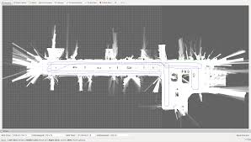
Gmapping:
One of SLAM method published in openslam, packaged in ROS.
Completed map:
2D Occupancy Grid Map (OGM) .
White = Free area where robot can move.
Black = Occupied area where robot can not move.
Gray = Unknown area.
Building a map using SLAM:
ROS Gmapping package is a wrapper of open source implementation of SLAM called Open_SLAM (https://www.openslam.org/gmapping.html ).
Which is the implementation of SLAM which helps to create a 2D occupancy grid map from the laser scan data and the mobile robot pose.
• The basic hardware requirement for doing SLAM:
Is a laser scanner which is horizontally mounted on the top of the robot.
And the robot odometry data.

Slide 28
Creating a launch file for gmapping:
1) The main task while creating a launch file for the gmapping process is to set the parameters
for the slam_gmapping node.
2) The slam_gmapping node is the core node inside the ROS gmapping package.
3) The slam_gmapping node subscribes the laser data ( sensor_msgs/LaserScan ) and the tf data,
and publishes the occupancy grid map data as output ( nav_msgs/OccupancyGrid ).
4) This node is highly configurable and we can fine tune the parameters to improve the mapping accuracy.
5) The parameters are mentioned at http://wiki.ros.org/gmapping .
Link explaining the process of drawing a map by gmapping:
https://drive.google.com/file/d/1Uao5hkHx5_1eh3DpeWx7H46gvf01rE4h/view?usp=drivesdk

Slide 29
Localization)AMCL( :
The ROS AMCL package provide nodes for localizing the robot on a static map.
The AMCL node subscribes the laser scan data, laser scan based maps, and the tf information from the robot.
The AMCL node estimates the pose of the robot on the map and publishes its estimated position with respect to the map.
If we create a static map from the laser scan data, the robot can autonomously navigate from any pose of the map using AMCL and the “move_base” nodes.
The first step is to create a launch file for starting the AMCL node.
The amcl node is highly customizable; we can configure it with a lot of parameters.
The list of parameters is available in the ROS package site (http://wiki.ros.org/amcl)

Slide 30
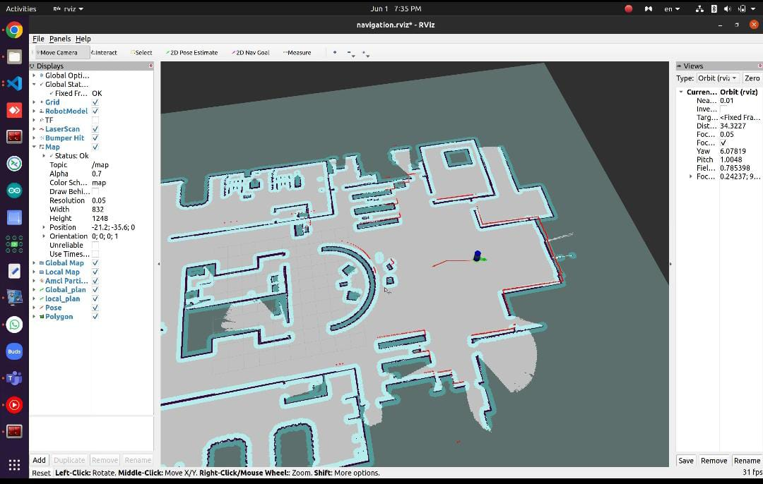

Slide 31
Navigation:
ROS Navigation stack:
The main aim of the ROS navigation package is to move a robot from the start position to the goal position, without making any collision with the environment.
The ROS Navigation package comes with an implementation of several navigation related algorithms which can easily help implement autonomous navigation in the mobile robots.
The user only needs to feed the goal position of the robot and the robot odometry data from sensors such as wheel encoders, IMU, and GPS, along with other sensor data streams such as laser scanner data or 3D point cloud from sensors like Kinect.
The output of the Navigation package will be the velocity commands which will drive the robot to the given goal position.
The Navigation stack contains implementation of the standard algorithms, such as SLAM, A *(star), Dijkstra, AMCL, and so on, which can directly be used in our application.

Slide 32
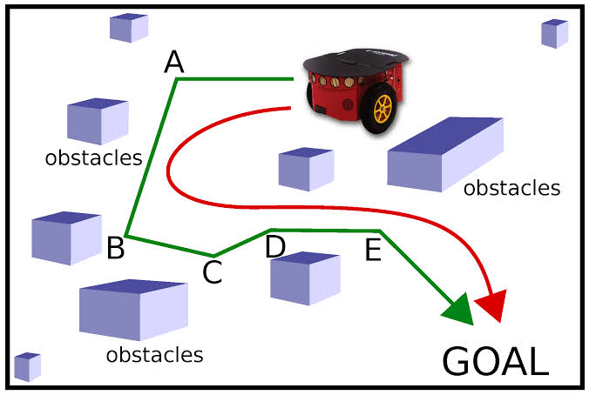
All the blocks which are provided as input to the Navigational stack:
Odometry Source
2) Sensor Source
3) Base_Controller:
4) Sensor Transforms/tf
5) Mapping (map_server)
Amcl
The move_base node:
The move_base node is from a package called move_base.
The main function of this package is to move a robot from its current position to a goal position with he help of other Navigation nodes.
The move_base node inside this package links the global-planner and the local-planner for the path planning, connecting to the rotate-recovery package if the robot is stuck in some obstacle and connecting global costmap and local costmap for getting the map.

Slide 33
Conclusion & Future Work
Future work:
Enhanced Human-Robot Interaction (HRI): Future work could focus on improving the interaction between nurse robots and patients. This includes developing more advanced natural language processing (NLP) capabilities, better voice recognition, and more intuitive touch interfaces to ensure that patients feel comfortable and understood when interacting with robots.
Advanced AI and Machine Learning: Implementing more sophisticated AI and machine learning algorithms can enable nurse robots to learn from their interactions and improve their performance over time. This includes better decision-making abilities, predictive analytics for patient care, and adaptive learning to handle a wider range of tasks and scenarios.
Design a Mobile App: to Control the Robot instead of RVIZ

Slide 34
Conclusion:
In summary, the nurse robot project represents a promising innovation in healthcare delivery, offering a blend of human expertise and technological capabilities to enhance patient care and optimize hospital operations. With proper planning, collaboration, and adaptation, the integration of nurse robots into hospital settings has the potential to revolutionize the way healthcare is delivered, ultimately improving patient outcomes and experiences in the modern healthcare landscape.

Slide 35


